Slide 1
Tuples and lists
tuples
lists
mutability
list comprehension
for-if, for-for
list()
any(), all()
enumerate(), zip()

Slide 2

Tuples
Python shell
(1, 2, 3) (1, 2, 3) () () (42) 42 (42,) (42,) 1, 2 (1, 2) 42, (42,) x = (3, 7) x (3, 7) x = 4, 6 x (4, 6) x[1] = 42 TypeError: 'tuple' object does not support item assignment
(value₀, value₁, ... , value_{k-1})
Tuples can contain a sequence of zero or more elements, enclosed by ”(” and ”)”
Tuples are immutable
Tuple of length 0: ()
Tuple of length 1: (value,)
Note the comma to make a tuple of length one distinctive from an expression in parenthesis
In many contexts a tuple with ≥ 1 elements can be written without parenthesis
Accessors to lists also apply to tuples, slices, ...
Notes:
Tuples good to prevent unexpected changes to values, opposed to lists
[42,] is also valid with a trailing comma; useful when having one element per line with a trailing comma => easy to swap lines

Slide 3
Question – What value is ((42,)) ?
42
(42)
(42,)
((42,),)
Don’t know
Notes:
a = b

Slide 4
Question – What is x ?
x = [1, [2, 3], (4, 5)]
x[2][0] = 42
[1, [42, 3], (4, 5)]
[1, [2, 3], (42, 5)]
[1, [2, 3], 42]
TypeError
Don’t know

Slide 5
Question – What tree is ('A',(('B','C'),'D')) ?
/\ /\ /\ /\ /\
/ \ / \ / \ / \ / \
/ \ / \ / \ / \ / \
/ \ / \ / \ / \ / \
/\ 'D' / \ / \ / \ 'A' /\
/ \ /\ 'D' /\ /\ 'A' /\ / \
/ \ / \ / \ / \ / \ / \
/\ 'C' / \ 'A' 'B' 'C' 'D' / \ 'B' /\
/ \ 'A' /\ /\ 'D' / \
'A' 'B' / \ / \ 'C' 'D'
'B' 'C' 'B' 'C'
b) c) d) e)
f) Don’t know
Notes:
Representing trees as nested tuples is the topic of handins 3 and 4.

Slide 6
Tuple assignment
Python shell
point = (10, 25) x, y = point x 10 y 25
Unpacking
Parallel assignments
x, y, z = a, b, c
is a shorthand for a tuple assignment (right side is a single tuple)
(x, y, z) = (a, b, c)
First the right-hand side is evaluated completely, and then the individual values of the tuple are assigned to x, y, z left-to-right (length must be equal on both sides)
Notes:
smurf = ("Papa", "Smurf", 546)
print(smurf[0], smurf[1], 'is', smurf[2], 'years old')
first_name, last_name, age = smurf # unpacking to make code readable
print(first_name, last_name, "is", age, "years old")
print(f”{first_name} {last_name} is {age} years old”)

Slide 7
Nested tuple/lists assignments
Let hand side can be nested (great for unpacking data)
(x, (y, (a[0], w)), a[1]) = 1, (2, (3, 4)), 5
[...] and (...) on left side matches both lists and tuples of equal length (but likely you would like to be consistent with type of parenthesis)
Python shell
two_points = [(10, 25), (30, 40)] (x1, y1, x2, y2) = two_points ValueError: not enough values to unpack (expected 4, got 2) ((x1, y1), (x2, y2)) = two_points a = [None, None] v = ((2, (3, 4)), 5) ((y, (a[0], w)), a[1]) = v a [3, 5] [x, y, z] = (3, 5, 7) (x, y, z) = [3, 5, 7] [x, (y, z), w] = (1, [2, 3], 4) [x, (y, z), w] = (1, [2, (5, 6)], 4) z (5, 6)

Slide 8
Unpacking a sequence with one element
Python shell
x = [42] # simple assignment x [42] x, = [42] # unpacking, implicit parenthesis x 42 (x,) = [42] # unpacking x 42 x, = [1, 2, 3] ValueError: too many values to unpack (expected 1)
Notes:
(x) = [42] # a simple assignment

Slide 9
Tuples vs lists: a += b
Python shell
(1, 2) + (3, 4) (1, 2, 3, 4) x = [1, 2] y = x y += [3, 4] y [1, 2, 3, 4] x [1, 2, 3, 4] x = (1, 2) y = x y += (3, 4) y (1, 2, 3, 4) x (1, 2)
Lists Extends existing list, i.e., same as a.extend(b)
Tuples Must create a new tuple a + b and assign to a (since tuples are immutable)
Notes:
Following also works…
x = [1,2,3]
x += (4,5,6)
x += range(10)
But the following not:
x = (1,2,3)
x += [4,5,6] # TypeError
[1,2,3] + (1,2,3) # TypeError

Slide 10
More on += on lists
Since a += b is the same as a.extend(b) we can also do
For tuples += only accepts tuples
Python shell
x = [1, 2, 3] x += [4, 5, 6] x += (7, 8, 9) x += range(10, 13) # 10, 11, 12 x += 'abc' # 'a', 'b', 'c' print(x) [1, 2, 3, 4, 5, 6, 7, 8, 9, 10, 11, 12, 'a', 'b', 'c’] x = [1, 2, 3] + (4, 5, 6) TypeError: can only concatenate list (not "tuple") to list
Notes:
The following fails:
x = (1,2,3)
x += [4,5,6] # TypeError
[1,2,3] + (1,2,3) # TypeError

Slide 11
*variable assignment
Python shell
(a, *b, c, d) = (1, 2, 3, 4, 5, 6) b [2, 3, 4] (a, *b, c, d) = (1, 2, 3) b [] (a, *b, c, d) = (1, 2) ValueError: not enough values to unpack (expected at least 3, got 2) v = ((1,2,3),4,5,6,(7,8,9,10)) ((a, *b), *c, (d, *e)) = v b [2, 3] c [4, 5, 6] e [8, 9, 10] head, *tail = [1, 2, 3, 4] head 1 tail [2, 3, 4]
For a tuple of variable length a single *variable name on the left side will be assigned a list of the remaining elements not matched by variables preceding/following *
Example
a, *b, c = t
is equivalent to
a = t[0]
b = t[1:-1]
c = t[-1]
There can be a single * in a left-hand-side tuple (but one new * in each nested tuple)
Notes:
row = (1,2,3,4,5)
first, _, third, *_ = row
vs
first = row[0]
third = row[2]

Slide 12
Question – What is b ?
(*a,(b,),c) = ((1,2),((3,4)),((5,)),(6))
(1,2)
(3,4)
5
(5,)
(6)
Don’t know
Python shell
(*a,(b,),c) = ((1,2),((3,4)),((5,)),(6)) a [(1, 2), (3, 4)] b 5 c 6

Slide 13
* in list and tuple construction
Python shell
A = (1, 2, 3) B = ['B', 'C'] L = [A, B, 4, 5] L [(1, 2, 3), ['B', 'C'], 4, 5] len(L) 4 L = [*A, *B, 4, 5] L [1, 2, 3, 'B', 'C', 4, 5] len(L) 7 (*A, *B, 4, 5) (1, 2, 3, 'B', 'C', 4, 5)
When constructing a list or tuple you can insert zero or more elements from another list/tuple/sequence by inserting *expression
There can be an arbitrary number of * expressions in a tuple or list construction
Python shell
from timeit import timeit timeit('A + A + A + A + A + A + A + A', setup='A = [1,2,3,4,5,6,7,8,9,10]') 0.665172699955292 # repeated concatenation can be slow timeit('[*A, *A, *A, *A, *A, *A, *A, *A]', setup='A = [1,2,3,4,5,6,7,8,9,10]') 0.32599859999027103 # * notation can be faster for multiple concatenation
Notes:
A * 8 would be even faster in this case ~ 0.2 sec
x = 'abc'
[x, *x, x]
['abc', 'a', 'b', 'c', 'abc']

Slide 14
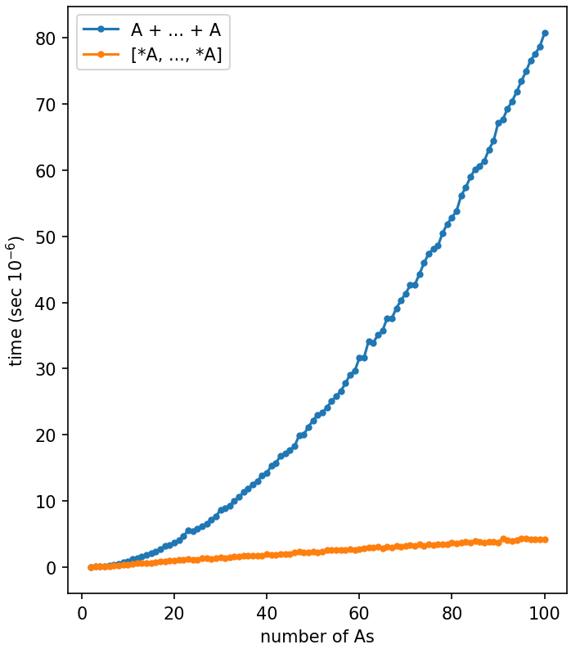
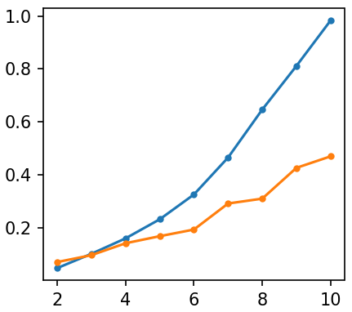
~ 0.0081 x²
list_catenation.py
import matplotlib.pyplot as plt from timeit import timeit ns = range(2, 101) P, S = [], [] for n in ns: setup = 'A = list(range(10))' plus = ' + '.join(['A'] * n) star = '[' + ', '.join(['*A'] * n) + ']’ P.append(timeit(plus, setup=setup)) S.append(timeit(star, setup=setup)) plt.plot(ns, P, '.-', label='A + ... + A') plt.plot(ns, S, '.-', label='[*A, ..., *A]') plt.legend() plt.ylabel('time (sec $10^{-6}$)') plt.xlabel('number of As') plt.show()
~ 0.046 x
Notes:
Likely never used in practice with many *s… would make a for loop and use ”extend” instead
Note: For <= 4 lists it does not appear to make a difference

Slide 15
List comprehension (cool stuff)
Example:
[x*x for x in [1, 2, 3]]
returns
[1, 4, 9]
General
[expression for variable in sequence]
returns a list, where expression is computed for each element in sequence assigned to variable
Python shell
[2*x for x in [1,2,3]] [2, 4, 6] [2*x for x in (1,2,3)] [2, 4, 6] [2*x for x in range(10,15)] [20, 22, 24, 26, 28] [2*x for x in 'abc'] ['aa', 'bb', 'cc'] [(None, None) for _ in range(2)] [(None, None), (None, None)]
Notes:
import random
[random.random() for _ in range(5)] # five different values
vs
[random.random()] * 5 # five identical values

Slide 16
List comprehension (it’s just syntactic sugar…)
Python shell
[x * 2 for x in [1, 2, 3]] [2, 4, 6] L = [] for x in [1, 2, 3]: L.append(x * 2) L [2, 4, 6]

Slide 17
List comprehension (more cool stuff)
Similarly, to the left-hand-side in assignments, the variable part can be a (nested) tuple of variables for unpacking elements:
[expression for tuple of variables in sequence]
Python shell
points = [(3, 4), (2, 5), (4, 7)] [(x, y, x*y) for (x, y) in points] [(3, 4, 12), (2, 5, 10), (4, 7, 28)] [(x, y, x*y) for x, y in points] [(3, 4, 12), (2, 5, 10), (4, 7, 28)] [x, y, x*y for (x, y) in points] SyntexError: invalid syntax
parenthesis required for the constructed tuples
Notes:
More unreadable alternatives:
[point + (point[0] * point[1],) for point in points]
[(*point, point[0] * point[1]) for point in points]

Slide 18
List comprehension – for-if and multiple for
List comprehensions can have nested for-loops
[expression for v₁ in s₁ for v₂ in s₂ for v₃ in s₃]
Can select a subset of the elements by adding an if-condition
[expression for v₁ in s₁ if condition]
and be combined...
Python shell
[(x, y) for x in range(1, 3) for y in range(4, 6)] [(1, 4), (1, 5), (2, 4), (2, 5)] [x for x in (1, 2) for x in (4, 5)] [4, 5, 4, 5] [x for x in range(1, 101) if x % 7 == 1 and x % 5 == 2] [22, 57, 92] [(x, y, x*y) for x in range(1, 11) if 6 <= x <= 7 for y in range(x, 11) if 6 <= y <= 7 and not x == y] [(6, 7, 42)]
Notes:
for x for x – usefull when both are ”_” and you don’t care about the variable

Slide 19
Question – What will print the same?
points = [(3,7), (4,10), (12,3), (9,11), (7,5)]
print([(x, y) for x, y in points if x < y])
print([x, y for x, y in points if x < y])
print([(x, y) for p in points if p[0] < p[1]])
print([p for p in points if p[0] < p[1]])
print([[x, y] for x, y in points if x < y])
Don’t know
Notes:
syntax-error
x and y not defined
d) list of lists instead of list of tuples

Slide 20
List comprehension – space usage long lists
Bad: creates new tuples
(64 bytes per point)
Good: looks nice
list_comprehension_space_usage.py
input('press enter') points = [(x, x + 1) for x in range(10_000_000)] # dummy points input('press enter') selected = [(x, y) for (x, y) in points if y == x + 1] input('press enter') selected = [point for point in points if point[1] == point[0] + 1] input('press enter')
4.2 MB
1306.1 MB
1995.5 MB
1385.5 MB
Good: refers to existing tuple
(8 bytes per point)
Bad: looks ugly (hard to read)
Memory usage according to “Task Manager” in Windows
Unpacking makes code more readable, but creating new tuples requires additional space…
Notes:
Set “selected = None; points = None” to free memory
selected = all points
Python 3.11 space usage:
Tuple 40 + 8 * length => tuple length 2 has size 56 + size of elements
List 56 + 8 * length (including reserved space slots)
x and y point to the original values in memory

Slide 21
any, all
Python shell
any((False, True, False)) True any([False, False, False]) False any([]) False all([False, False, True]) False all((True, True, True)) True all(()) True L = (7, 42, 13) any([x == 42 for x in L]) True all([x == 42 for x in L]) False
any(L) checks if at least one element in the sequence L is true (list, tuple, ranges, sequence, strings, ...)
any([False, True, False])
all(L) checks if all elements in the sequence L are true
all([False, False, True])
any and all return True or False

Slide 22
Example – computing primes
Python shell
[x for x in range(2, 50) if all([x % f for f in range(2, x)])] [2, 3, 5, 7, 11, 13, 17, 19, 23, 29, 31, 37, 41, 43, 47] [10 % f for f in range(2, 10)] [0, 1, 2, 0, 4, 3, 2, 1] all([10 % f for f in range(2, 10)]) # == 0 is considered False False [13 % f for f in range(2, 13)] [1, 1, 1, 3, 1, 6, 5, 4, 3, 2, 1] all([13 % f for f in range(2, 13)]) True
Notes:
By dropping innermost ”[” ”]” and using a generator expression instead, not all f need to be considered before applying all.
Reduces running time by a factor 5 for range(2, 1000).
from timeit import timeit
timeit('len([x for x in range(2, 25000) if all(x % f for f in range(2, x))])', number = 1)
1.643209399888292
timeit('len([x for x in range(2, 25000) if all([x % f for f in range(2, x)])])', number = 1)
10.774596799863502

Slide 23
enumerate
list(enumerate(L))
returns
[(0, L[0]), (1, L[1]), ..., (len(L) - 1, L[-1])]
Python shell
points = [(1, 2), (3, 4), (5, 6)] [(idx, x * y) for idx, (x, y) in enumerate(points)] [(0, 2), (1, 12), (2,30)] L = ('a', 'b', 'c') list(enumerate(L)) [(0, 'a'), (1, 'b'), (2, 'c')] L_ = [] for idx in range(len(L)): L_.append((idx, L[idx])) print(L_) [(0, 'a'), (1, 'b'), (2, 'c')] list(enumerate(['a', 'b', 'c'], start=7)) [(7, 'a'), (8, 'b'), (9, 'c')]
Notes:
Enumerate returns an enumerate object, typically used with for-loops
Enumerate iterates over the argument and returns pairs
A = [1,2,3]
for idx, x in enumerate(A):
if x % 2:
A[idx] = x + 1
print(A)

Slide 24
zip
list(zip(L₁,L₂,...,L_{k})) = [(L₁[0],L₂[0],...,L_{k}[0]),...,(L₁[n-1],L₂[n-1],...,L_{k}[n-1])]
where n = min(len(L₁), len(L₂),..., len(L_{k}))
Example (“matrix transpose”):
list(zip([1,2,3],
[4,5,6],
[7,8,9]))
returns
[(1, 4, 7),
(2, 5, 8),
(3, 6, 9)]
Python shell
x = [1, 2, 3] y = [4, 5, 6] zip(x, y) <zip at 0xb02b530> points = list(zip(x, y)) print(points) [(1, 4), (2, 5), (3, 6)]
Notes:
list(zip([1,2],[3,4,5])) # drops 5
[(1, 3), (2, 4)]
list(zip([1,2],[3,4,5], strict=True)) # ‘strict’ siden 3.13
ValueError: zip() argument 2 is longer than argument 1

Slide 25
Python shell
first = ['Donald', 'Mickey', 'Scrooge'] last = ['Duck', 'Mouse', 'McDuck'] for i, (a, b) in enumerate(zip(first, last), start=1): print(i, a, b) 1 Donald Duck 2 Mickey Mouse 3 Scrooge McDuck

Slide 26
(Simple) functions
Python shell
def sum3(x, y, z): return x + y + z sum3(1, 2, 3) 6 sum3(5, 7, 9) 21 def powers(L, power): P = [x**power for x in L] return P powers([2, 3, 4], 3) [8, 27, 64]
You can define your own functions using:
def function-name (var₁, ..., var_{k}):
body code
If the body code executes
return expression
the result of expression will be returned by the function. If expression is omitted or the body code terminates without performing return, then None is returned
When calling a function name(value₁,..., value_{k})body code is executed with var_{i}=value_{i}
Notes:
Can be used for structuring your code for the various exercises:
def exercise_1_1():
pass
def exercise_1_2(n):
print(f'Exercise 1.2 - {n =}')
print(sum(range(1, n+1)))
def exercise_1_3():
pass
#exercise_1_1()
exercise_1_2(10)
exercise_1_2(100)
#exercise_1_3()

Slide 27
Question – What tuple is printed ?
def even(x):
if x % 2 == 0:
return True
else:
return False
print((even(7), even(6)))
(False, False)
(False, True)
(True, False)
(True, True)
Don’t know
Notes:
Better:
def even(x):
return x % 2

Slide 28
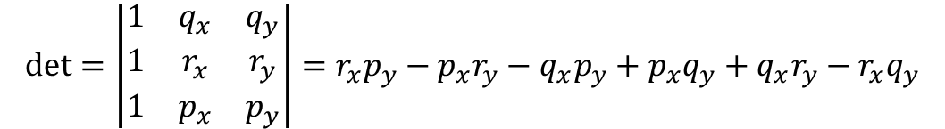
Geometric orientation test
det = 0
det > 0
p
180 ° < α < 360°
Purpose of example
illustrate tuples
list comprehension
matplotlib.pyplot
floats are strange
0 ° < α < 180°
r
= (24, 24)
det < 0
y
q
= (12, 12)
(0.5, 0.5)
(0.5+ε, 0.5+ε)
x
$$\text{det}=\left|\begin{matrix}1 & q_{x} & q_{y} \\ 1 & r_{x} & r_{y} \\ 1 & p_{x} & p_{y}\end{matrix}\right|=r_{x}p_{y}−p_{x}r_{y}−q_{x}p_{y}+p_{x}q_{y}+q_{x}r_{y}−r_{x}q_{y}$$
Kettner, Mehlhorn, Pion, Schirra, Yap: Classroom Examples of Robustness Problems in Geometric Computations
6 ! = 720 different orders to add

Slide 29
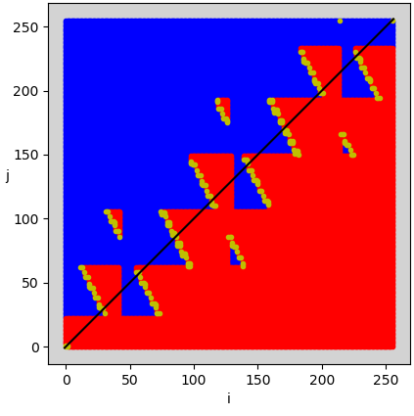
sign-plot.py
import matplotlib.pyplot as plt N = 256 delta = 1 / 2**54 q = (12, 12) r = (24, 24) P = [] # points (i, j, det) for i in range(N): for j in range(N): p = (1/2 + i * delta, 1/2 + j * delta) det = (q[0]*r[1] + r[0]*p[1] + p[0]*q[1] - r[0]*q[1] - p[0]*r[1] - q[0]*p[1]) P.append((i, j, det)) pos = [(i, j) for i, j, det in P if det > 0] neg = [(i, j) for i, j, det in P if det < 0] zero = [(i, j) for i, j, det in P if det == 0] plt.subplot(facecolor='lightgrey', aspect='equal') plt.xlabel('i') plt.ylabel('j', rotation=0) for points, color in [(pos, 'b'), (neg, 'r'), (zero, 'y')]: X = [i for i, j in points] Y = [j for i, j in points] plt.plot(X, Y, color + '. ') plt.plot([-1, N], [-1, N], 'k-') plt.show()
(0.5000000000000142, 0.5000000000000142)
(0.5, 0.5)
det > 0
det = 0
det < 0
Notes:
Epsilon = 256 * delta = 1 / 2 ** 46 = 1.42 e-14

Slide 30
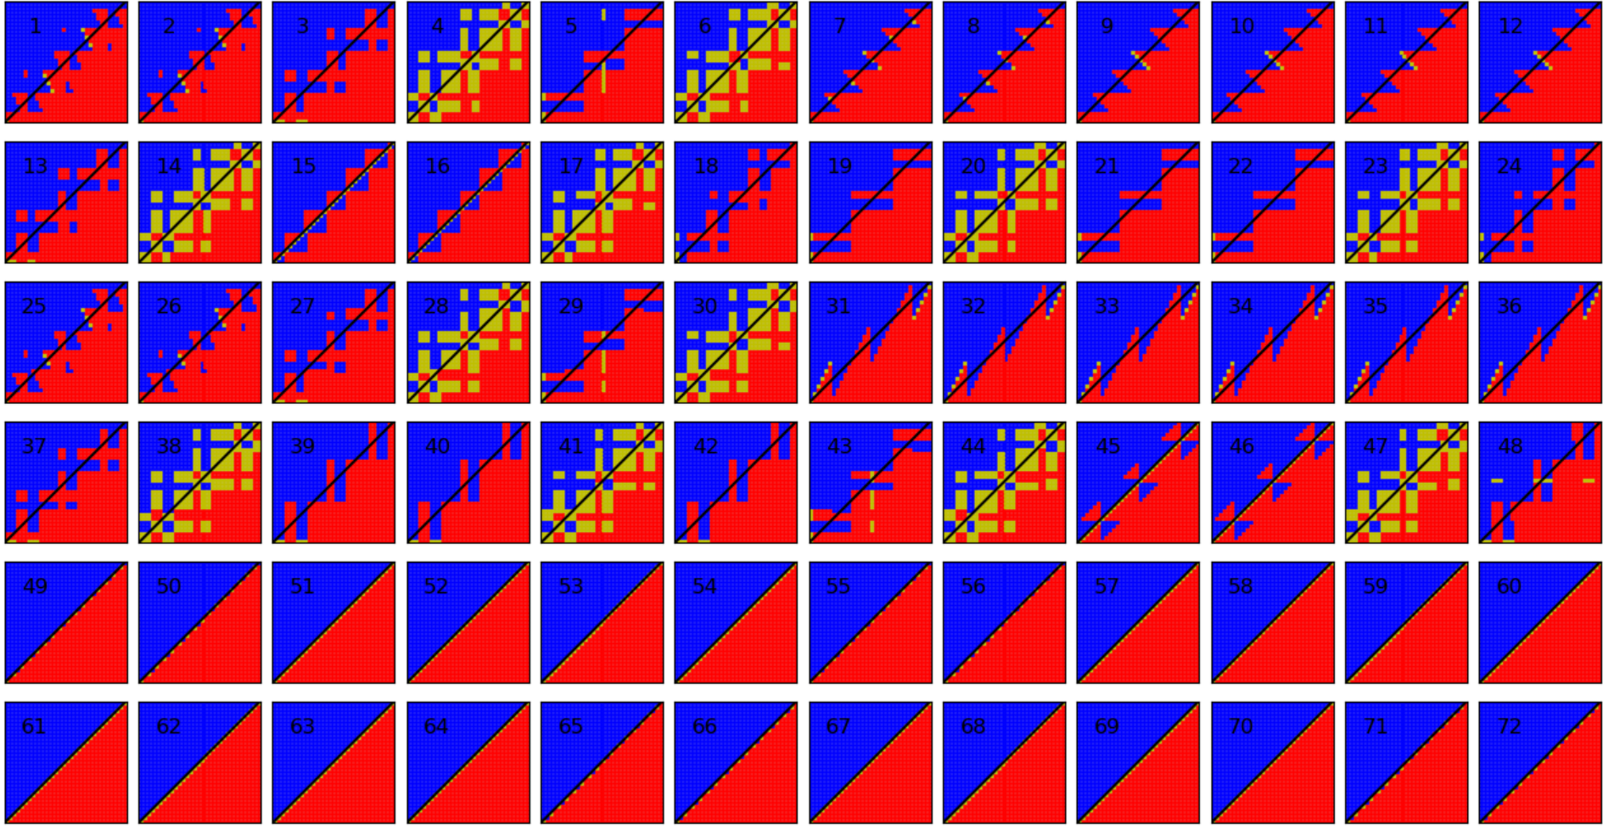

Slide 31
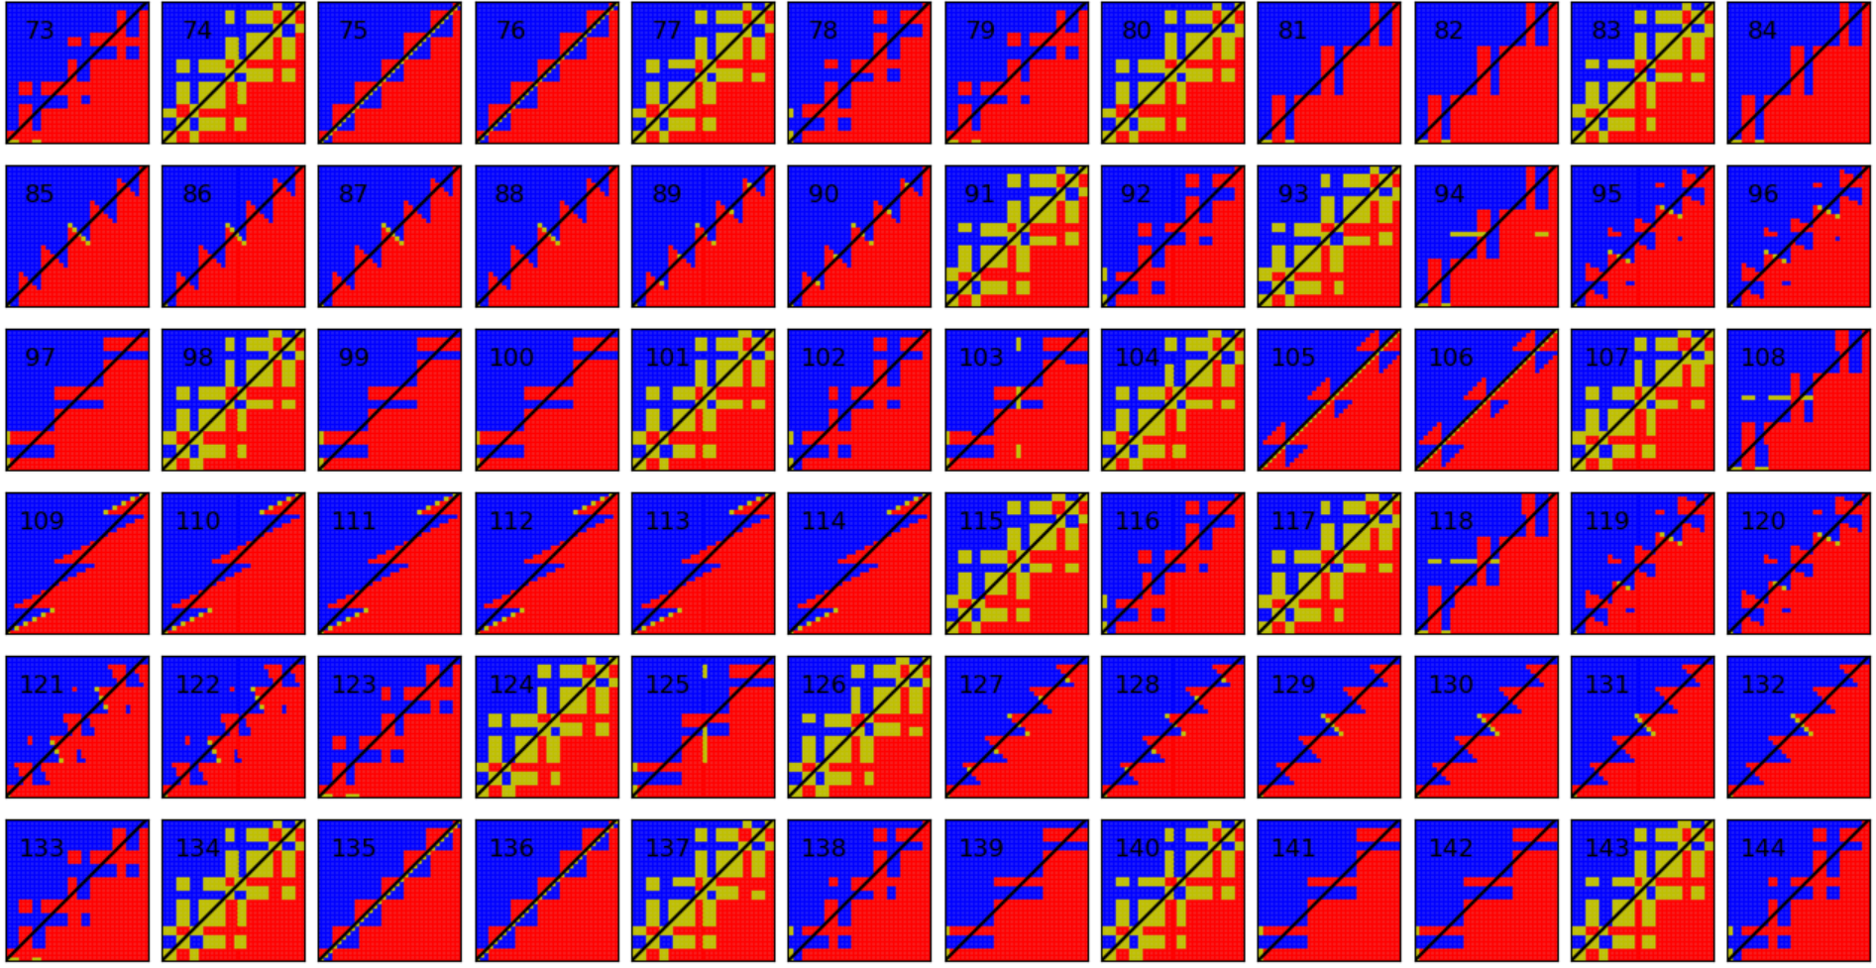

Slide 32
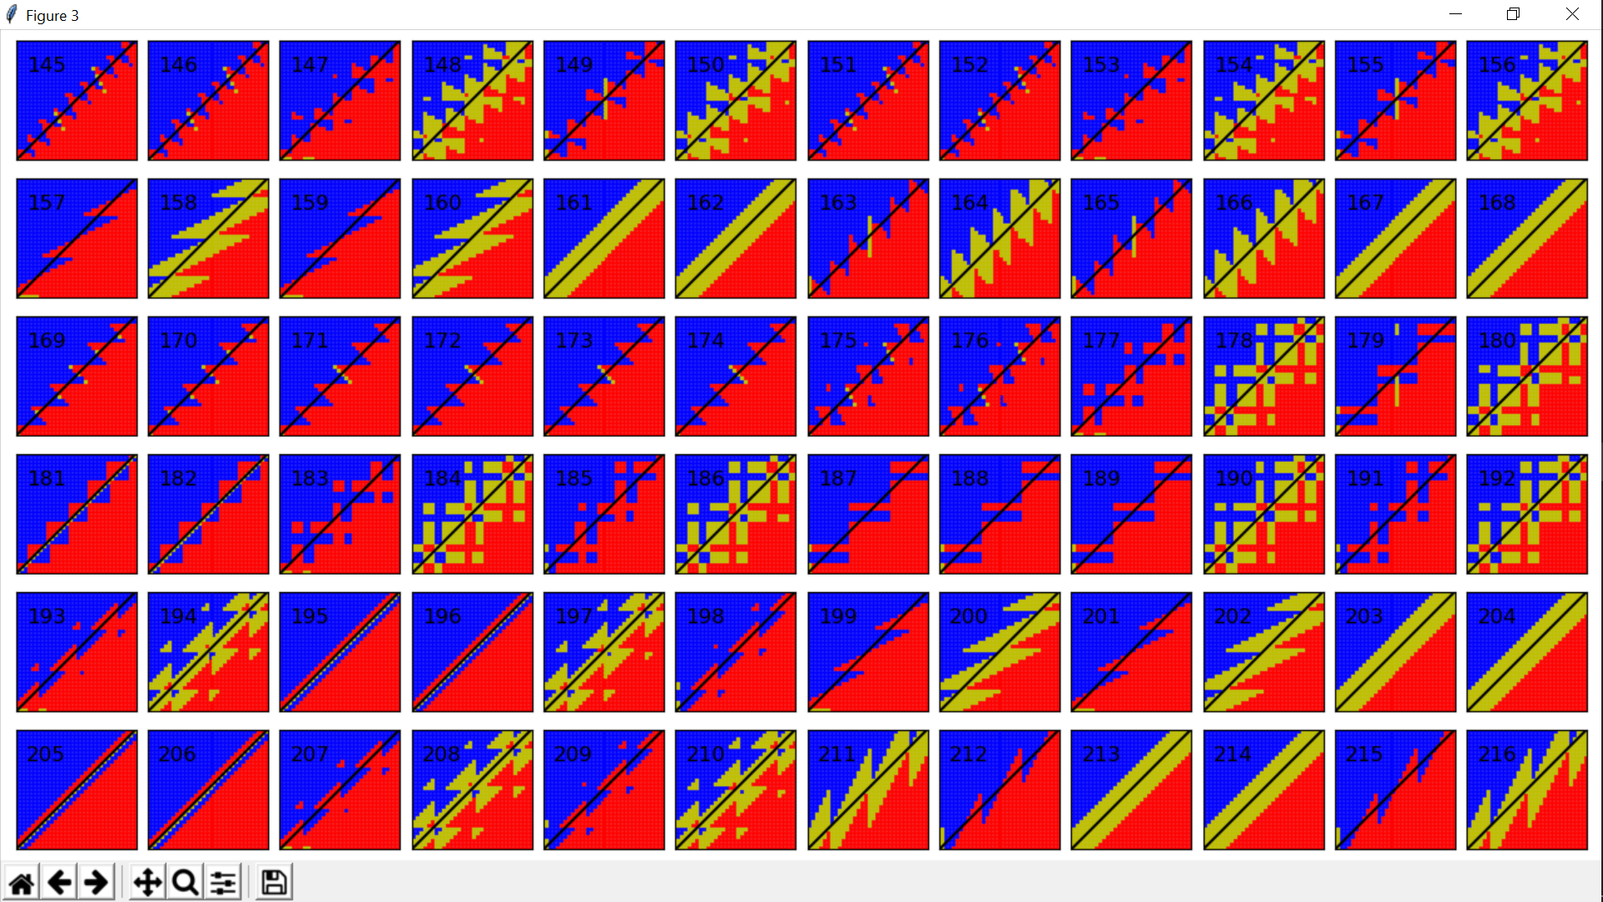

Slide 33
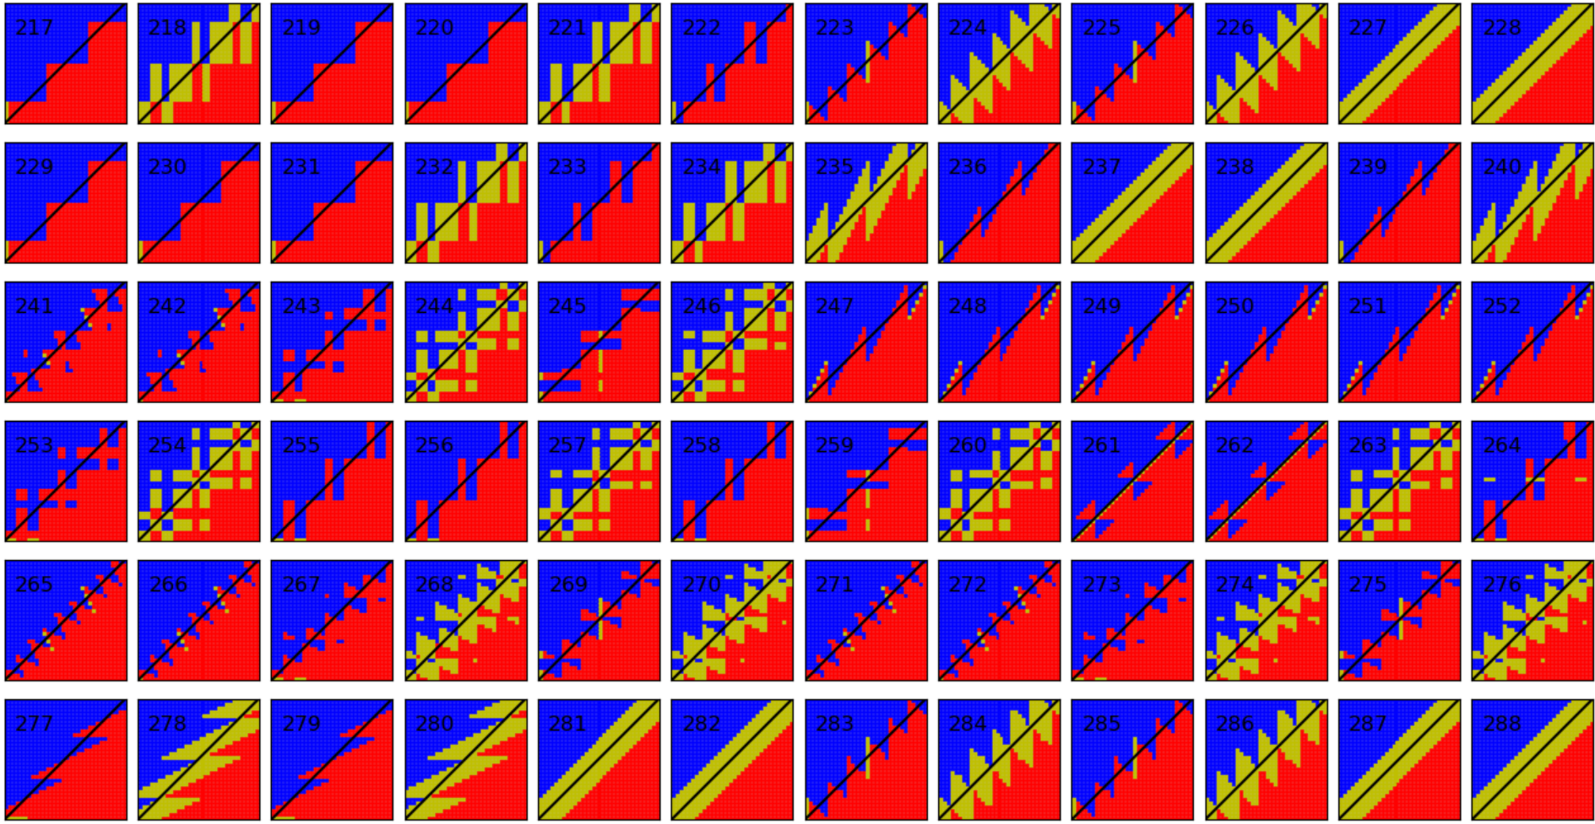

Slide 34
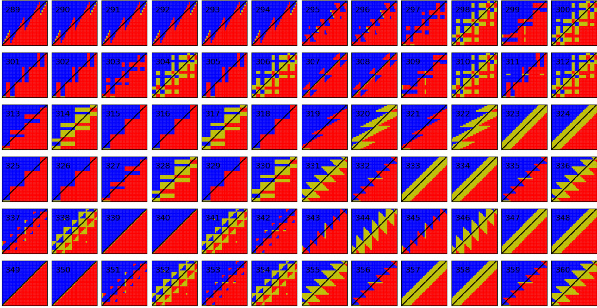

Slide 35
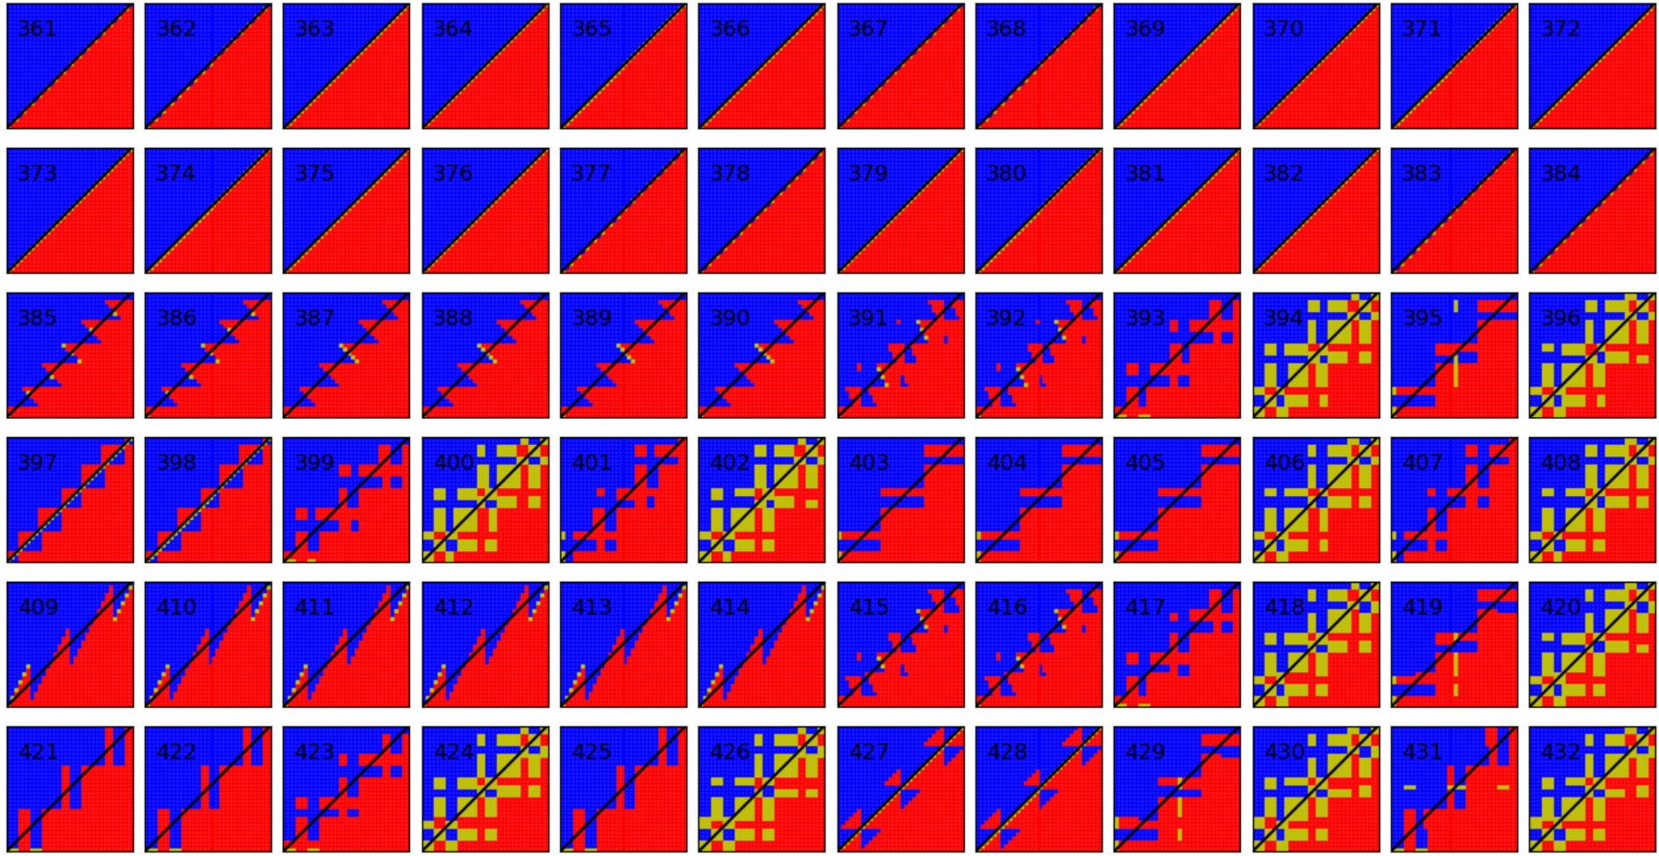

Slide 36
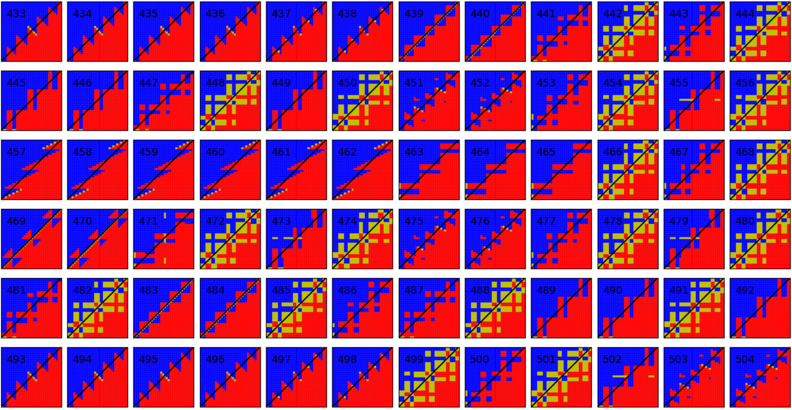

Slide 37
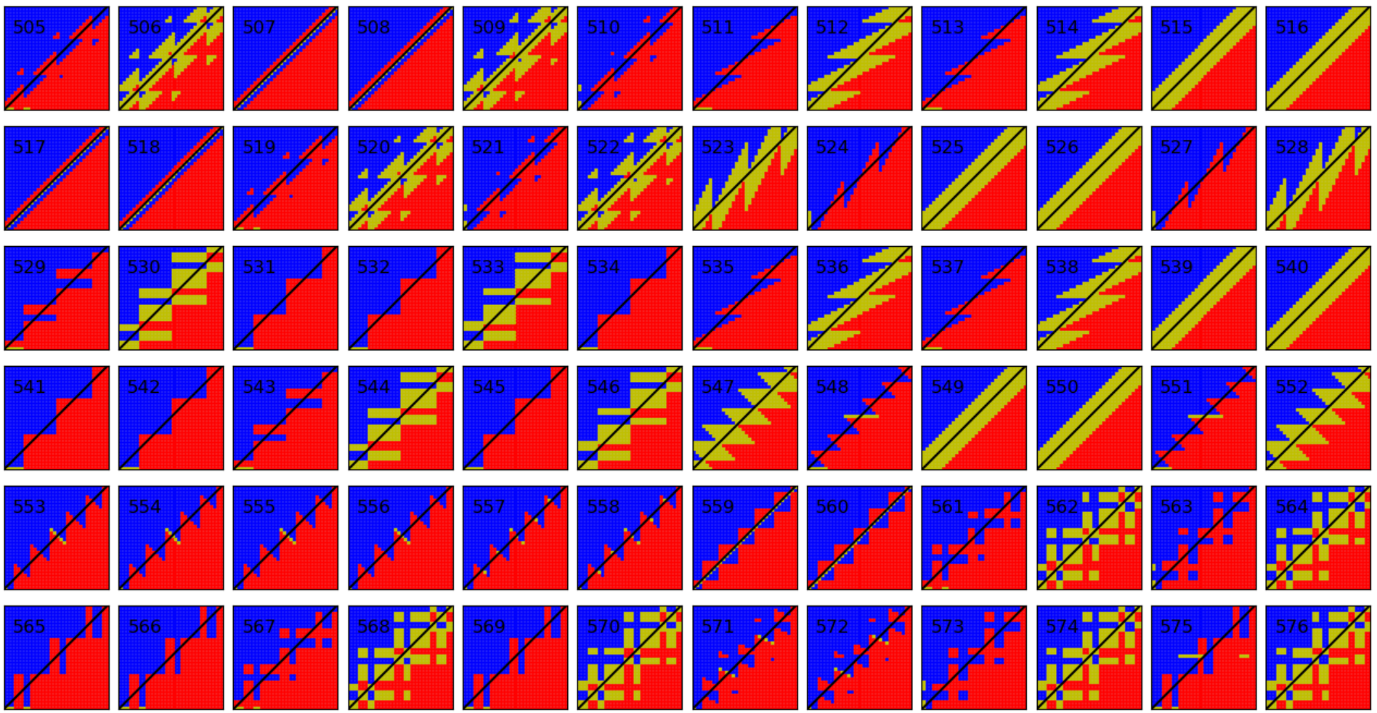

Slide 38
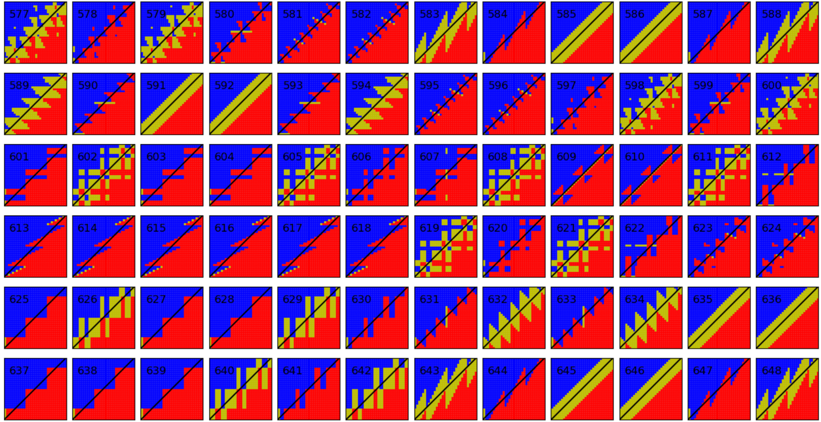

Slide 39
